Slide 1
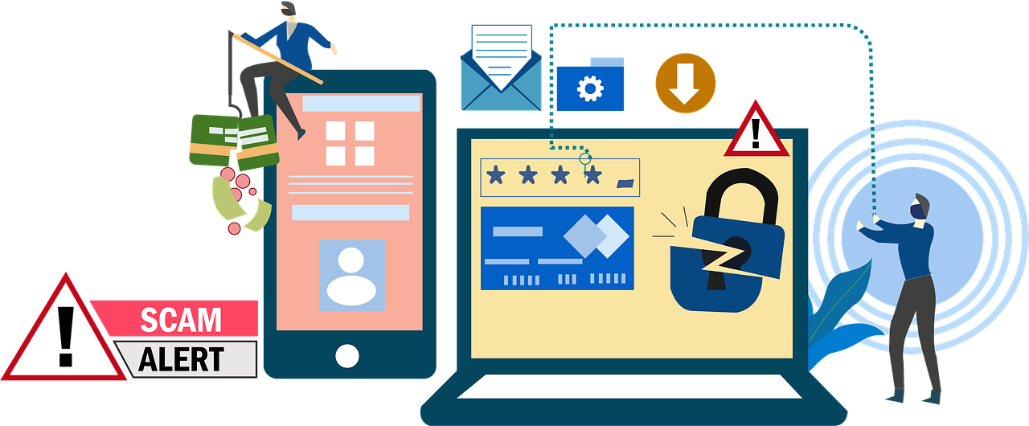
Introduction to Phishing Awareness
Welcome! Today, we're focusing on HR & Marketing teams to help strengthen our security posture.
Phishing is a cyber attack where criminals try to trick you into giving away sensitive information (passwords, financial details, etc.).
These attacks often appear to come from legitimate sources, like emails, but they’re designed to steal data or install malware.
Remember: Phishing can happen to anyone—but with awareness, you can avoid the trap!

Slide 2
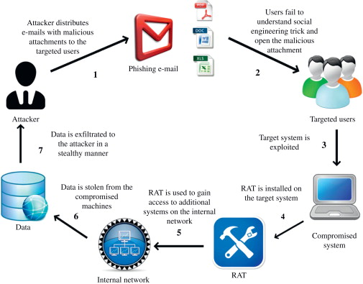
Common Phishing Tactics

Slide 3
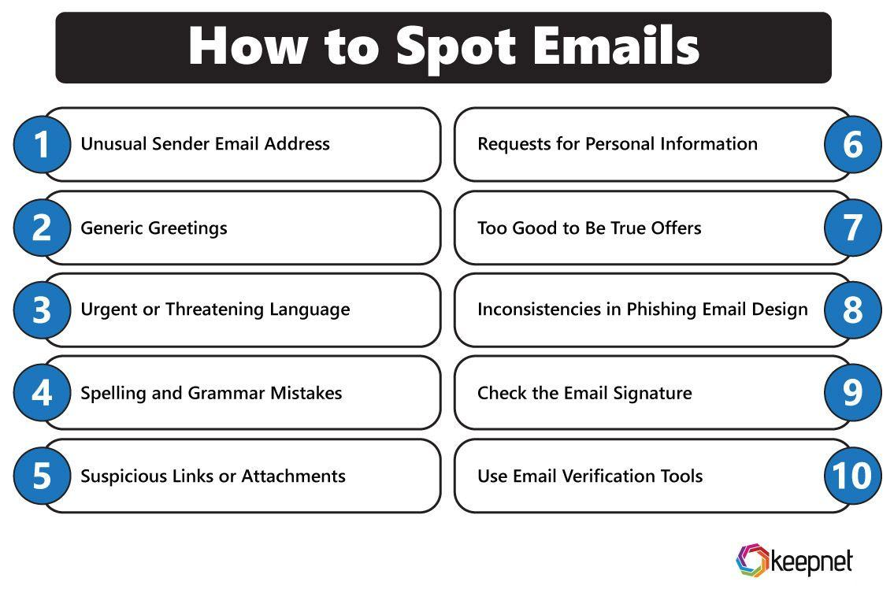
Spotting the Phish: Quick Tips

Slide 4
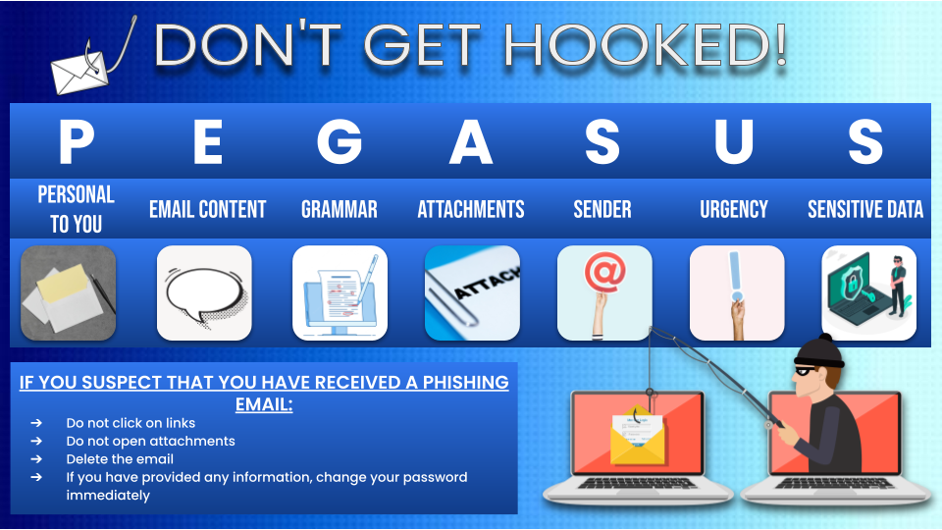
How do we stop getting phished?
<add some helpful tips and hints to stay vigilant about phishing>

Slide 5
